Slide 1

Team 2
Kevin Rodrigues (QA Manager) Sharvani Kadarla (Software Tester) Nimisha George (QA Analyst) Koushika Chappidi (Software Tester) Sreenitha Rayapuraju (Business Analyst)

Slide 2
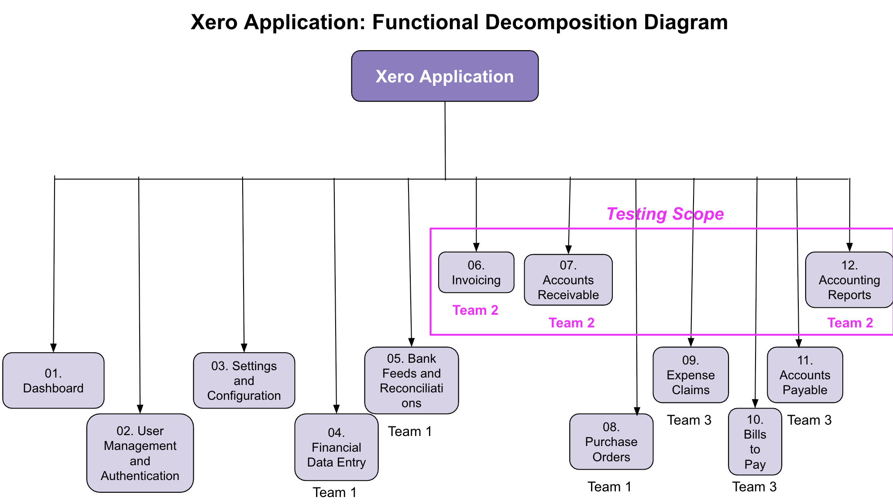
Functional Decomposition Diagram
(presented by Koushika Chappidi)
Xero Application: Functional Decomposition Diagram

Slide 3
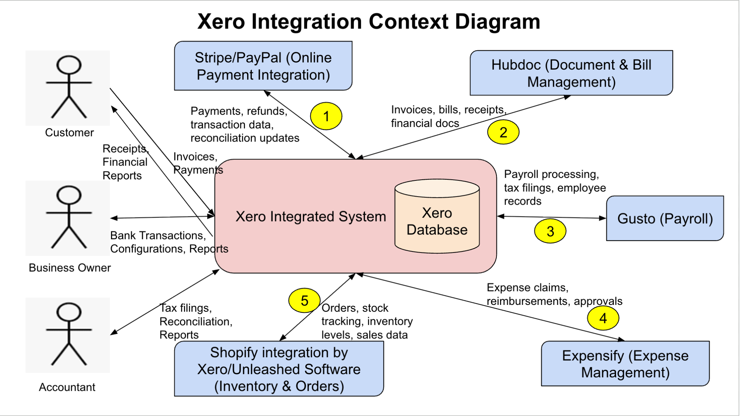
Context Diagram
(presented by Sreenitha Rayapuraju)

Slide 4
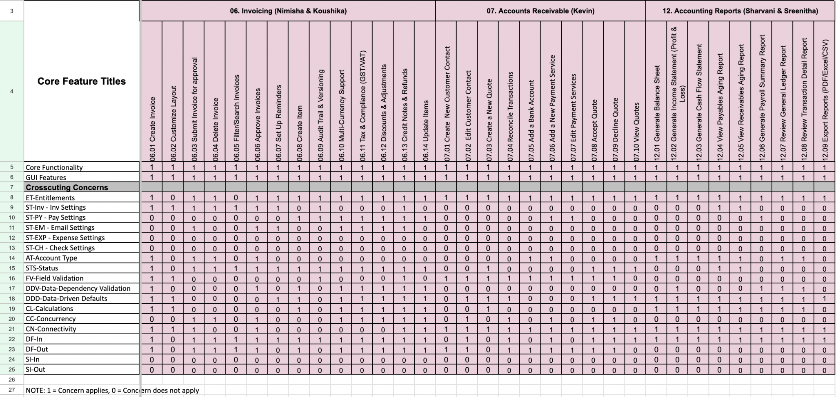
Requirements Composition Table (RCT) (presented by Nimisha George)

Slide 5
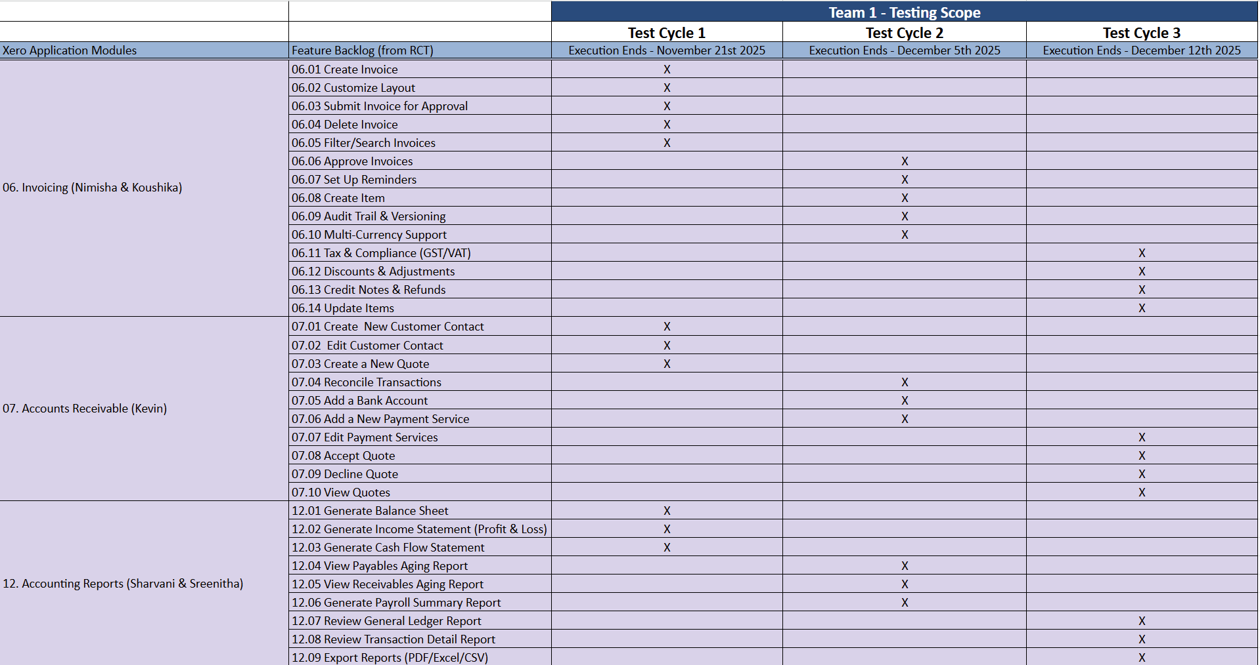
Testing RoadMap
(presented by Sharvani Kadarla)

Slide 6
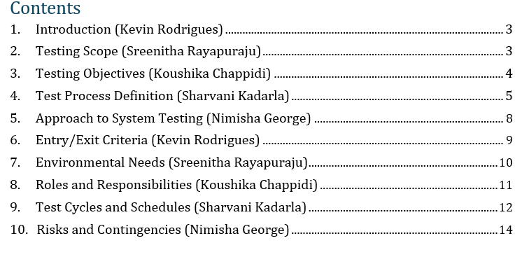
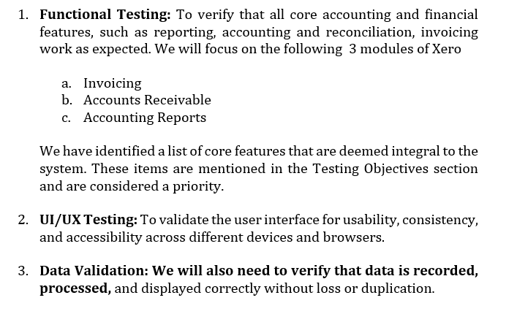
Test Plan
(presented by Kevin Rodrigues)

Slide 7
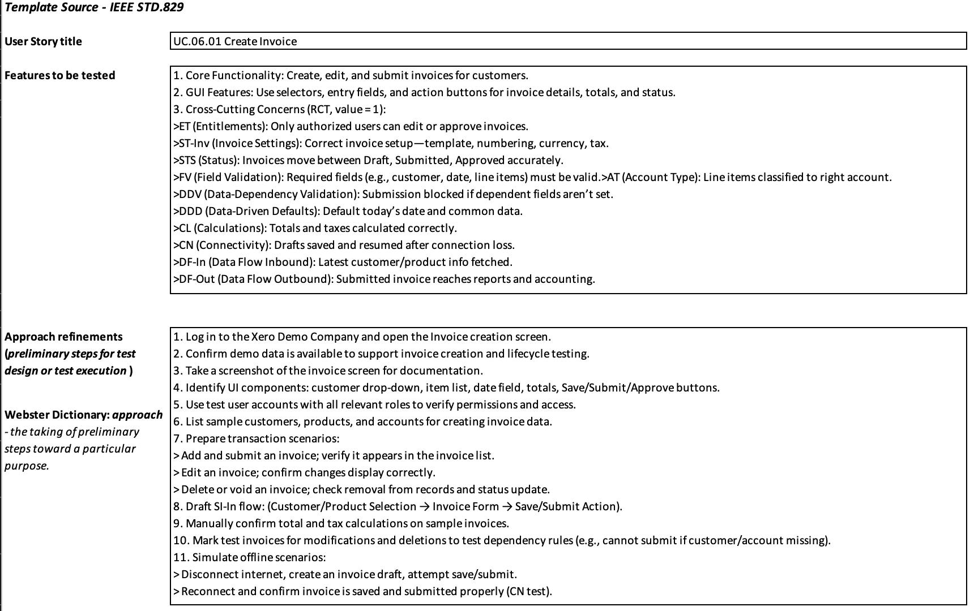
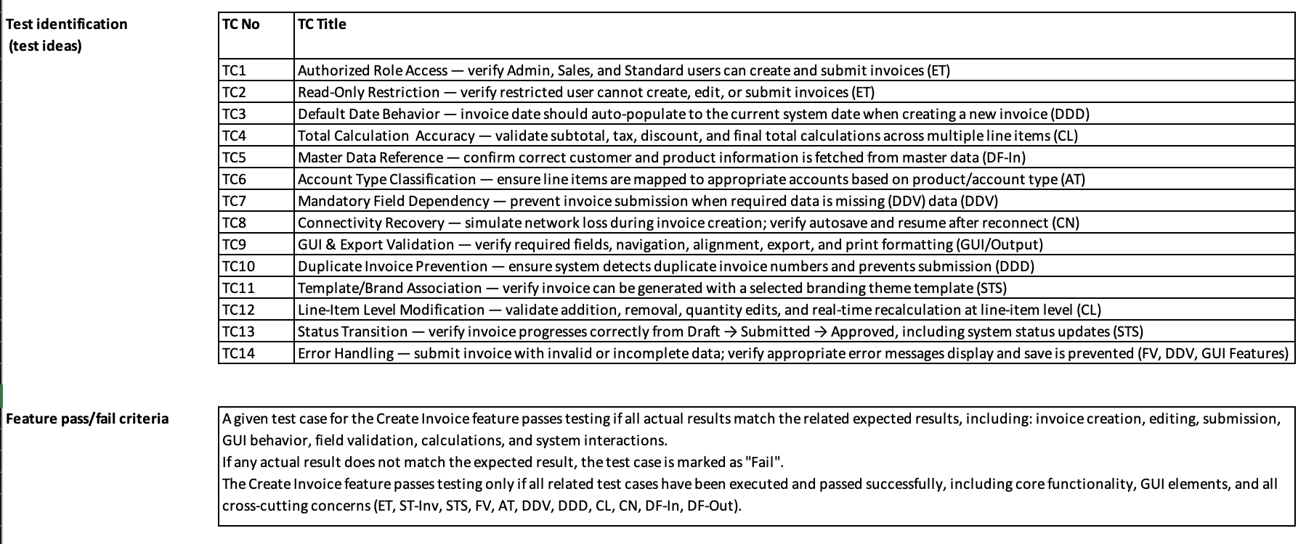
Test Design Specification
(presented by Nimisha George)

Slide 8
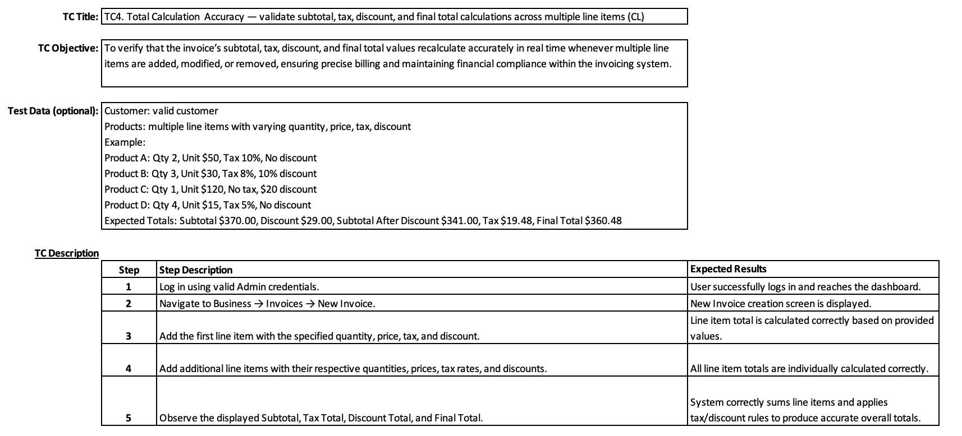
Test Case Specification
(presented by Sreenitha Rayapuraju)

Slide 9
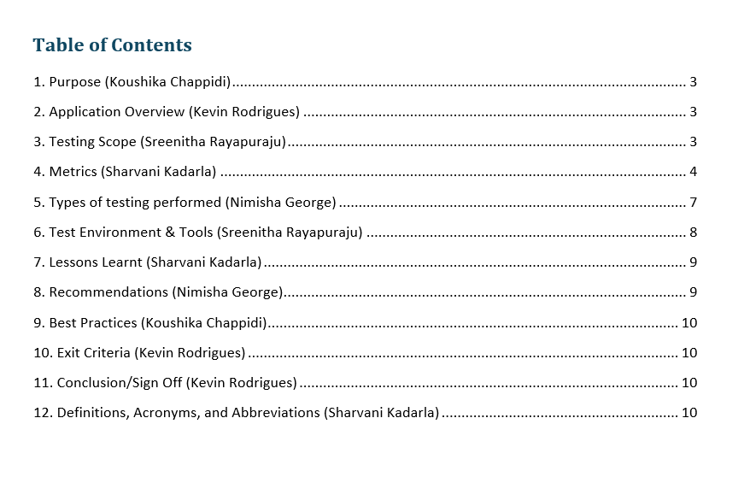
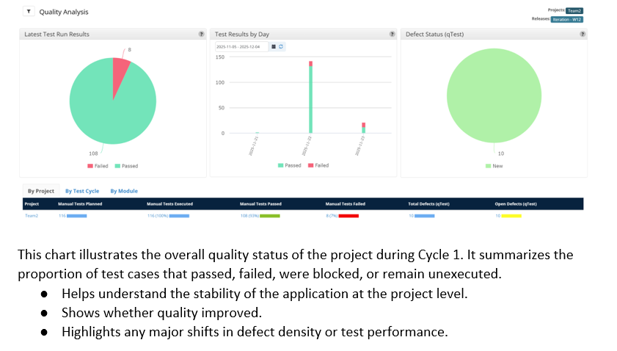
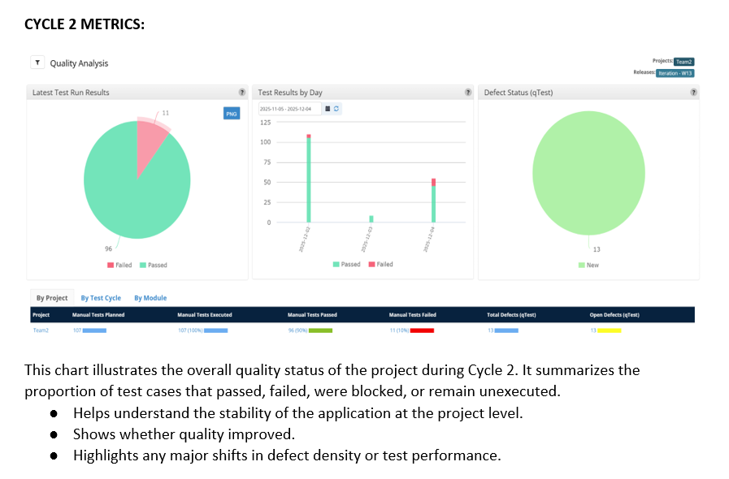
Test Summary Report
(presented by Kevin Rodrigues)

Slide 10
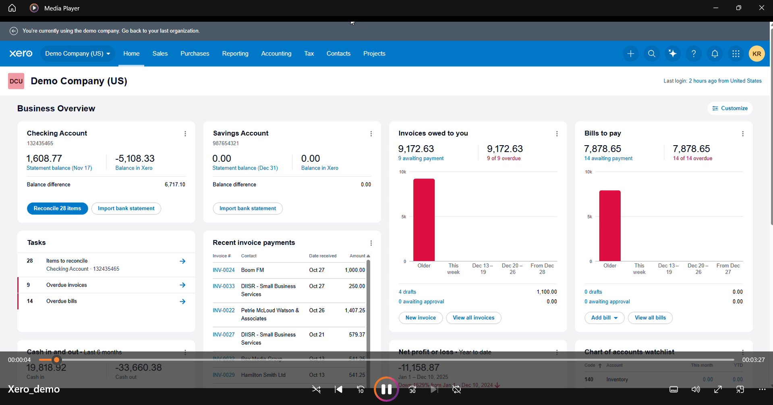
Application Recorded Demo
(presented by Kevin Rodrigues)

Slide 11
Appendix:
GitHub Repository

Slide 12

GitHub Repo Link
https://github.com/kevinr78/Team2_AST

Slide 13

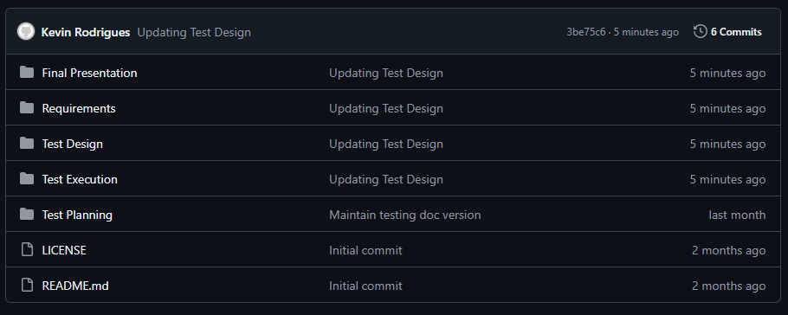


GitHub Repo Folder Structure
Requirements
Test Planning
Test Design
Test Execution
Final Presentation
README.md

Slide 14
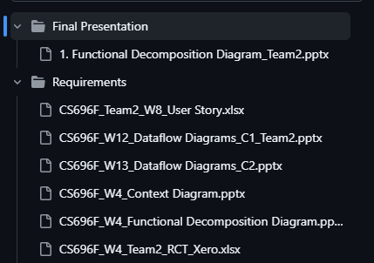
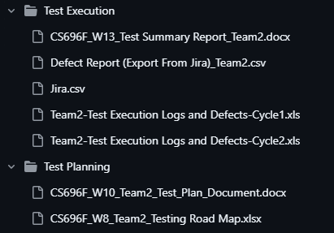
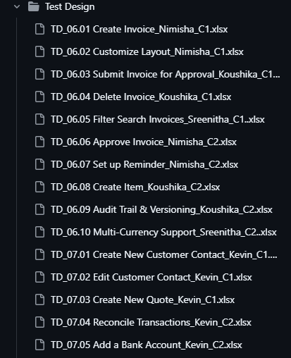
GitHub Repo Folder Structure

Slide 15
Thank You

